Slide 1


Strengthening Global Governance to
Prevent Threats & Reduce Risks to Human Existence
A Collaborative Initiative advanced by the InterAction Council and One Young World
High Level Meeting, House of Lords
9th January 2024
Comments to: drjonurse@gmail.com
Dr Jo Nurse, Strategic Advisor, InterAction Council
Director, Platform for Planet Place and People (P4PPP)
Chair, Existential Risks for Humanity working group,
World Academy of Art and Science

Slide 2
Changing Drivers for
Global Security
PEOPLE
NATIONAL
Pandemics
Impacts:
Sustainable
Development
Goals and
Human
Security
Unknown Risks:
Emerging
Technologies
Global
Security
Planetary
Emergency
Conflict &
Migration
PLANET
PEACE
GLOBAL

Slide 3
CONTEXT
Proactive versus Reactive:
Strategic Foresight to identify threats
and risks to Human Existence
Sustainable
Development
Goals – SDGs
2015
Future
UN Futures Summit 2023-2024:
Areas of Potential Action suggested by UNSG:
Account for the Future – including our Future Generations
Respond to Global Shocks – Emergency Platform
Include Young People
Measure Human Progress – beyond GDP
Vision of Digital Technology – reduce harms & maximize benefits
Integrity in Public Information – safe and inclusive
Reform International Financial Architecture – for the SDGs
Peaceful and Sustainable Outer Space – governance norms
A New Agenda for Peace
Transform Education
UN 2.0 – include strategic foresight
UN Pact for the Future 2024 +
Sendai
Framework
Paris
Agreement
Identify and Address
Widespread and
Cross-Cutting
Challenges to
the Survival,
Livelihood
& Dignity
of People
Human
Security
1990s +
People-Centred,
Comprehensive,
Context Specific &
Prevention Orientated
Responses that
Strengthen the
Protection &
Empowerment
of All People
Notes:
https://www.un.org/humansecurity/what-is-human-security/
https://www.un.org/en/common-agenda/summit-of-the-future

Slide 4
Existential Threats and Risks for All
Existential threats potentially risk the extinction of life including the human species
In order to resonate with the essential determinants for human survival reflected by the Sustainable Development Goals, existential threats are considered under the SDG clusters of Planet, Peace, People and Prosperity:
Planet: threats range from mass -extinctions from asteroids, massive volcanic eruptions and biodiversity collapse to threats from our climate emergency
People: inequalities, food and water insecurity act as drivers for migration and conflict, whilst a warming planet increases the risk of pandemics with the potential to threaten human existence
Peace: nuclear, chemical and biological warfare including engineered pandemics; Digital Warfare and Artificial Intelligence
Prosperity: Mechanical- Technical- Industrialisation including unsustainable growth (planet); unhealthy crowded cities and rapid travel (pandemics) and widening inequalities (peace); human security risks are posed from emerging technology including Quantum Computing and genetic engineering

Slide 5
Key Existential Threats, Risks, Impacts and Timescales
Threats | Risks | Impacts | Timescales
Planet | High: Runaway Tipping Points | Catastrophic Biodiversity Collapse with Mass Extinctions | Critical next few years as Tipping Points are already being exceeded
People | High: Future Pandemics | Low Fatality- weakens global security High Fatality –potential for catastrophic impacts | COVID continues to evolve new variants Synthetic infections are already possible to create
Peace | High: Conflict and Nuclear disaster in Europe | Potential for escalation of Nuclear explosions Nuclear Winter devastates food & water | Exists whilst conflicts have availability to nuclear reactors and weapons
Prosperity | High: Emerging Technology Unsustainable Growth | Uncontrollable catastrophic impacts from Artifical General Intelligence (AGI) | AGI is likely to emerge within the next 3-5 years
Other | Uncertain: Volcanoes, Asteroids | Causes of previous Mass Extinctions | Uncertain

Slide 6
CONTEXT: The Escalating Nexus of Existential Threats and Risks
Planet:
Climate Emergency
Tipping Point Risks
Hothouse Earth
Biodiversity Crisis
Mass Extinctions
People:
Pandemics
Food Security
Water Security
Heat related Deaths
Mass Migration
Hu
Planet
People
Peace
Prosperity
Peace:
Nuclear catastrophe
Biological & Chemical Warfare
Synthetic Biology
Digital Warfare
WW III
Prosperity:
Unsustainable Growth (Planet)
Urban crowding (People)
Inequalities (Peace)
Emerging Tech
Nurse J, 2023
Notes:
https://www.routledge.com/Leadership-Lessons-from-a-Global-Health-Crisis-From-the-Pandemic-to-the/Nurse/p/book/9781032010038?gclid=CjwKCAjw5_GmBhBIEiwA5QSMxD2bow6stCma_JmfByWtfNLikKw5-5-Oo4frcHTjiqtKCvrccEI15hoCQiQQAvD_BwE
https://www.cadmusjournal.org/article/volume-5-issue-2/hs-existential-threats

Slide 7
Vision: Create a Flourishing and Safe World for All
To Secure the Well Being of Our Future Generations
Aim to Prevent Cascades:
Pandemics
Violence & Nuclear War
Escalation of Climate Tipping Points
Existential Threats from Emerging Tech
Goals – Prevention and Risk Reduction:
Primary Prevention: whereby the onset of the threat or hazard is prevented from occurring
Secondary Prevention: early detection and warning systems with early interventions are applied to halt and reverse progression of hazards – this is often seen as risk reduction, resilience and adaptation
Tertiary Prevention: to make an established problem less severe in order to improve outcomes – this relates to the concepts of mitigation and recovery
Risk Reduction: minimise the likelihood and scale of consequences and impacts
Aim to Reduce Risks and Promote Resilience & Recovery:
Planetary Emergency
Disasters
Notes:
https://www.cadmusjournal.org/article/volume-5-issue-2/hs-existential-threats

Slide 8
Strategic Foresight for a Strategic Plan:
GOVERNANCE
CONTEXT: SHORT and LONGTERM RISKS and BARRIERS
Assessment
Analysis
Scenarios
Interventions
STRATEGIC PLAN: MULTI-DISCIPLINARY SUSTAINABLE SYSTEMS
DESIGN and DELIVER with PARTNERS

Slide 9
Strategy X – EXIST: A Plan to Save Humanity
Strategic Sustainable Systems – Prevention & Risk Reduction
Planet: prevent tipping points from escalating and creating runaway climate change; create a strategic Global Emergency response to stabilise our Essential Determinants of Life on this Planet including Temperature, Air, Water, Land and Food systems and to assist in recovery
People: prevent future Pandemics – through enhanced global governance with regional and local coordination, create One Health systems for prevention, detection, early warning systems, preparedness and response; transform global health security as a global good with digital solutions
Peace: prevent violence within families and communities, and create inclusive and fair societies to promote a culture of peace; identify risks for conflicts for early intervention with diplomacy and development for pathways to peace including intercountry initiatives; advocate for and agree on common global rights and responsibilities, and implement controls for technologies and weapons of mass-destruction; adopt no first use policies, remove hair trigger alerts and pledge no use of nuclear weapons
Prosperity: Scale renewable energy to underpin Human Security, Sustainable Development and Growth; Establish Global Governance for Digital Technology and AI to reduce risks and enhance beneficial solutions; promote open access Health and Education, Research and Innovation to create a flourishing world for all

Slide 10
GOVERNANCE: A GLOBAL SECURITY COUNCIL
FOR EXISTENTIAL THREATS
VISION
& VALUES
GOVERNANCE ARCHITECTURE
Secretariat
COORDINATION & COMMUNICATION
PREVENTION
RESILIENCE & RISK
PREPAREDNESS
EARY ALERTS
RESPONSE
RECOVERY
Partners:
PLANET
PEOPLE
PEACE
Youth
Council
SECURITY COUNCIL for EXISTENTIAL THREATS
‘ONE PLANET HEALTH’ SYSTEMS
Partners
DIGITAL TRANSFORMATION
INCLUSIVE LEADERSHIP FOR PLANET, PEOPLE & PEACE

Slide 11
GOVERNANCE
A Global Futures Platform – for Planet, People and Peace
GOVERNANCE:
Human Security Council
Global Strategy & Coordination
Declaration for the Future
Emergency Platform
People for the Planet
Youth Council
ADVOCACY:
Youth Leadership
Leaders for Emergencies
Civil Society Engagement
Resilient Communities
Hu
KNOWLEDGE
Planet
ADVOCACY
Invest at scale:
Green Energy
Transition
Prevention of Threats
Sustainable Development
Nature-based
Solutions
Governance solutions:
Global Goods
Treaties
Risks
Technology
Future
Well-Being
CAPACITY
People
Peace
KNOWLEDGE:
Risk Platform
Early Warning
Threshold Indicators
Knowledge Transfer
Research & Innovation
CAPACITY:
Education & Workforce
Whole Earth Health Systems
Infrastructure & Engineering
Digital Transformation
Notes:
Nurse J, (2023) ‘Leadership Lessons from a Global Health Crisis – from the Pandemic to the Climate Emergency’ Routledge. https://www.routledge.com/Leadership-Lessons-from-a-Global-Health-Crisis-From-the-Pandemic-to-the/Nurse/p/book/9781032010038?gclid=CjwKCAjwloynBhBbEiwAGY25dPtLspmgjNk8CWL4kbxYQTyQN4ynZNcnuacwdEbRyDvtlRAtA84cwRoCKbYQAvD_BwE
Nurse J (2023) ‘Towards an Artificial Intelligence Governance Framework’ Briefing for the InterAction Council: https://www.interactioncouncil.org/publications/briefing-towards-artificial-intelligence-governance-framework
Nurse J et al (2023) ‘Digital Solutions to Transform the Climate Crisis and Our Planetary Emergency – Creating Global Goods to Secure a Healthy Planet for All’ Platform for Planet, Place and People, a Hub of the Commonwealth Centre for Digital Health. https://drive.google.com/file/d/15a1kwlvmYPzor7ua4GMjEF4Os48eC2qm/view
Nurse J (2023) ‘Human Security and Existential Threats – A Governance Framework for Planet, Peace, People and Prosperity’ Cadmus, World Academy of Art and Science. http://cadmusjournal.org/article/volume-5-issue-2/hs-existential-threats

Slide 12
Advancing Recommendations:
A Global Youth Security Council for Existential Threats
Launched at the One Young World Summit, Belfast 2023
YOUTH:
A Global Youth Security Council for Existential
Threats
GOVERNANCE: A Global Security Council for the Planet, People and Peace
STRATEGY: A Plan to Secure the Future of Humanity from Existential Threats
PLATFORM: A Global Futures Platform - for the Planet, People and Peace
ADVOCACY: A Media Campaign for Strategy X – EXIST and to engage communities in the Well-Being of Future Generations
PARTNERS: Establish an Alliance of Partners for the Planet, People and Peace
LEADERS: Create Courageous and Inclusive Leadership for Emergencies and Global Security
A Global Security Council for Existential
Threats
https://www.interactioncouncil.org/index.php/our-work/meetings/high-level-expert-group-meetings/towards-global-youth-council-prevent-existential
Notes:
https://www.cadmusjournal.org/article/volume-5-issue-2/hs-existential-threats

Slide 13
A Global Security Council for Existential Threats
Global Youth Security Council - Exist
Co-Chairs
Strategy X – EXIST: A Living Plan and Process
KNOWLEDGE
ADVOCACY
LEADERSHIP
Secretariat
Planet
Committees
Future
Well-Being
Create
Flourishing
Communities
+ the
World
We Want
People
Peace
Partners
& Alliance
Working
Groups
A Global Futures Platform – for Planet, People and Peace

Slide 14
Proposed Process
Establish the Council and Develop a Strategy - 2024- 2026:
Co-chairs to invite proposed members onto the Global Council for Existential Threats, run in parallel/ back-to-back with a series of High-Level Expert Meetings that combine experts, partners, and policy makers to develop the strategic plan for the following themes:
Planet, People, Peace
Governance and Leadership
AI and Digital Solutions
Establish Committees and Working Groups:
Foresight, Planet, People, Peace, Governance, Leadership, Partners etc
Global Futures Platform – for Planet, People and Peace (expand P4PPP)
Advocacy Campaign: develop a multi-media and community arts campaign with partners, combined with high-level political events, for example: the annual plenary of the InterAction Council, the One Young World Summit and UN Futures Summit in September 2024. Potential Future events to engage with: World Economic Forum, Munich Security Conference, World Health Summit etc

Slide 15
Next Steps:
Governance: Establish the governance process with a core group of leaders and youth council
Alliance: Engage supportive partners and donors
Strategy: Draft a Strategic Plan for consultation
Platform: Design a Global Futures Platform to enable strategic sustainable systems
Advocacy: Media Campaign, Launch, Champions and Events
Leaders: scale capacity for inclusive leadership skilled at prevention and risk management
Launch: 2024 – IAC/ OYW/ UN Futures Summit
Potential Role of Partners:
Advocacy
Convene Meetings / Conferences
Member of Council
Co-Chair / Member of Working Group or Committee
Advance initiatives in Strategy X –EXIST
Support the establishment & running of a Secretariat
Facilitate networks and partnerships
Provide Resources
Contact: Drjonurse@gmail.com
Notes:
https://www.interactioncouncil.org/
https://sites.google.com/view/p4ppp/resources
https://www.cadmusjournal.org/article/volume-5-issue-2/hs-existential-threats
https://www.routledge.com/Leadership-Lessons-from-a-Global-Health-Crisis-From-the-Pandemic-to-the/Nurse/p/book/9781032010038?gclid=Cj0KCQjwmvSoBhDOARIsAK6aV7jlYf-WFKHFHmixtVQL8rGjDm6CRre43xktms5otBvHpTZc5URCgNoaAjijEALw_wcB
https://sites.google.com/view/p4ppp/resources

Slide 16
Todays High Level Meeting:
Purpose - Strengthening Global Governance for Existential Threats
1.30pm – Stop Running in Circles – Lessons from the pandemic - Borja Cabezón, Embajador en Misión Especial COVID-19 y Salud Global, Government of Spain
1.40pm – Global Governance required to Prevent Pandemics – Recommendations from the Global Preparedness Monitoring Board - Professor Ilona Kickbusch, Graduate Institute of International Development Studies, Geneva
1.50pm – Existential Threats and Leadership – Alistair Fernie, CEO, The Elders 2.00pm – The Central Role of Young People in Governance for Existential Threats -
Statement by Mr Lloyd Jose Nunag from the Global Youth Council for Existential Threats, One Young World
2.10pm – Strengthening Global Governance to Prevent Threats and Reduce Risks to Human Existence - Discussion facilitated by Ella Robertson McKay, One Young World:
• Advancing a Global Security Council for Existential Threats – Comments on draft Terms of Reference: Function and Process, Objectives and Governance
Anticipated outcomes:
Improved Terms of Reference for a Global Security Council for Existential Threats
Outline next steps for advancing the Council and Strategy X – EXIST with partners

Slide 17
Draft Terms of Reference for Discussion
An intergenerational ‘Global Security Council for Existential Threats’
Purpose: To strengthen global and multi-lateral capabilities to prevent and reduce risks from
existential threats in order to ensure human survival
Young Leaders from OYW GYSC - EXIST – CO-CHAIRS – Former Heads of Government Group eg IAC
Functions and Processes:
Risk Assessment
Effective Actions
Sustainable Systems
Communicate Risks
Ethical Values
Multilateral Collaboration
Diplomacy
Objectives:
Governance – policy, legal & financial mechanisms
Strategy – develop and deliver a living plan/ processes
Advocacy – launch, plus a social media campaign
Platform – digital solutions, tools and coordination
Alliance – connect experts and collaborative partners
Leaders – education, skills & professional development
Membership:
International & Regional
Youth & Intergenerational
Indigenous/ Ethics/ Experts
Committee Chairs
Committees/ Working Groups:
Planet- People- Peace
Governance & Financing
Digital Futures Platform
Advocacy & Alliance
To be Established:
Relationship with
Member States and UN
Secretariat & Resources

Slide 18
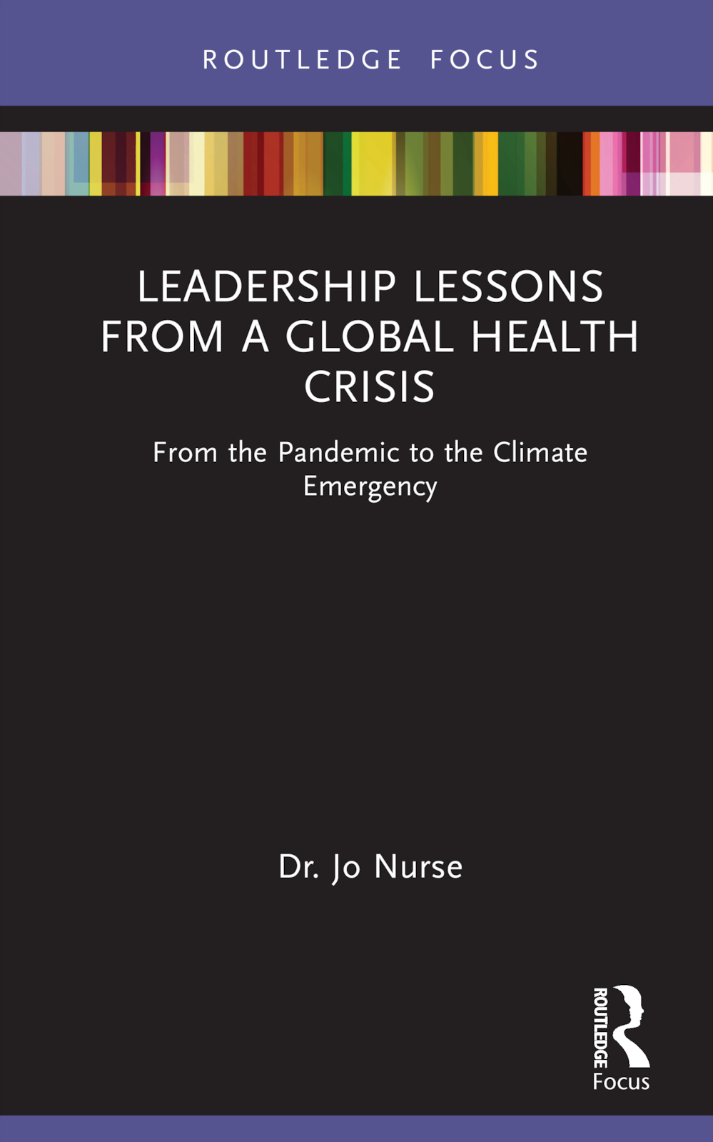
For Further Reading!
Leadership Lessons from a Global Health Crisis
From the Pandemic to the Climate Emergency
By Jo Nurse
This book explores the key learning for global leadership in response to the pandemic and argues the need for fundamental reform to governance paradigms, within the global security sphere and policymaking circles. Beginning with an analysis of the worldwide response to the COVID-19 pandemic, the book provides insights from evolution, history, and human behaviour to explain how our current leadership paradigms have contributed to today’s global health challenges. The book outlines future threats to human life and existence, including from our planetary emergency and draws lessons for the much larger crisis of climate change with the threat of massive biodiversity collapse. The second part of the book outlines tangible solutions to strengthen systems, transform leadership, governance and policy to enhance global security for both people and the planet, with the aim of averting future pandemics and threats to human existence including from our planetary emergency.
25% Discount Available - enter the code LLGHC25 at Routledge checkout
Contact: Drjonurse@gmail.com
https://www.routledge.com/Leadership-Lessons-from-a-Global-Health-Crisis-From-the-Pandemic-to-the/Nurse/p/book/9781032010038
Notes:
https://www.interactioncouncil.org/
https://sites.google.com/view/p4ppp/resources
https://www.cadmusjournal.org/article/volume-5-issue-2/hs-existential-threats
https://www.routledge.com/Leadership-Lessons-from-a-Global-Health-Crisis-From-the-Pandemic-to-the/Nurse/p/book/9781032010038?gclid=Cj0KCQjwmvSoBhDOARIsAK6aV7jlYf-WFKHFHmixtVQL8rGjDm6CRre43xktms5otBvHpTZc5URCgNoaAjijEALw_wcB
https://sites.google.com/view/p4ppp/resources

